Slide 1
E-Shop 2024 Customer’s Analysis

Slide 2
AGENDA
EDA
Clustering with RFM
Prediction Model
Dashboard

Slide 3
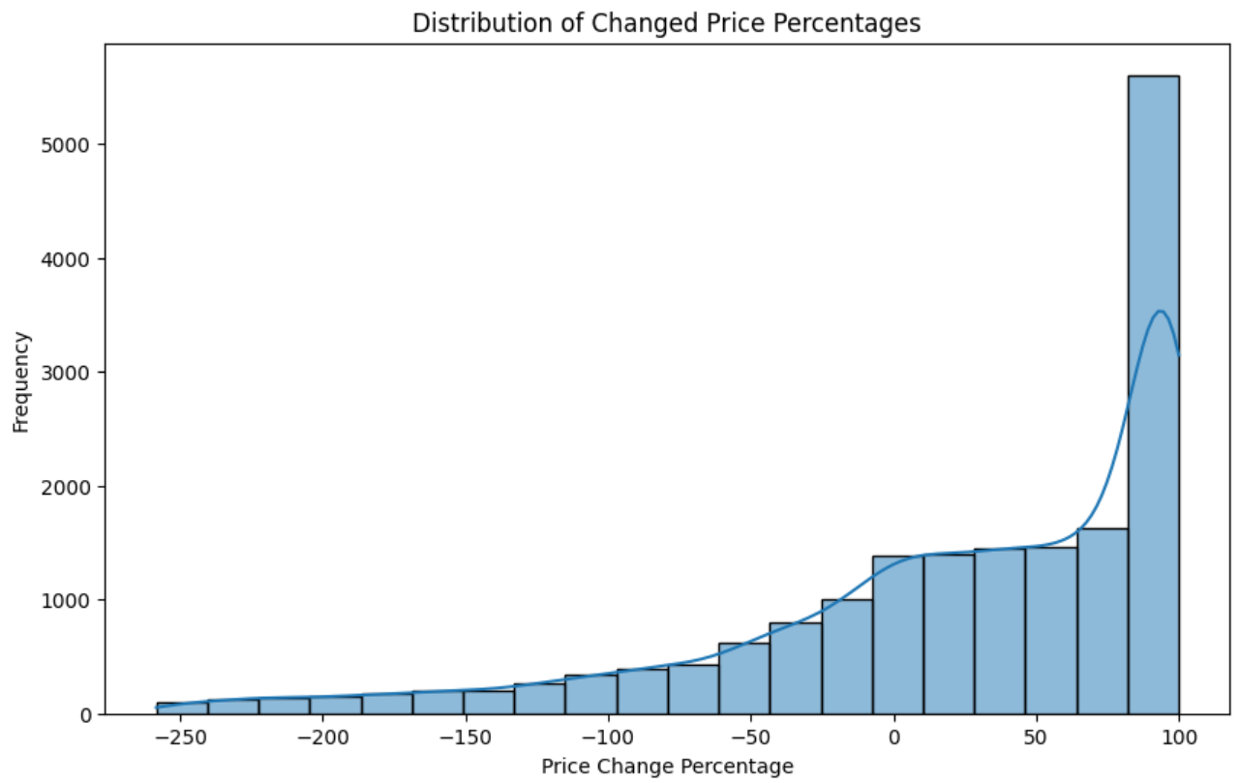
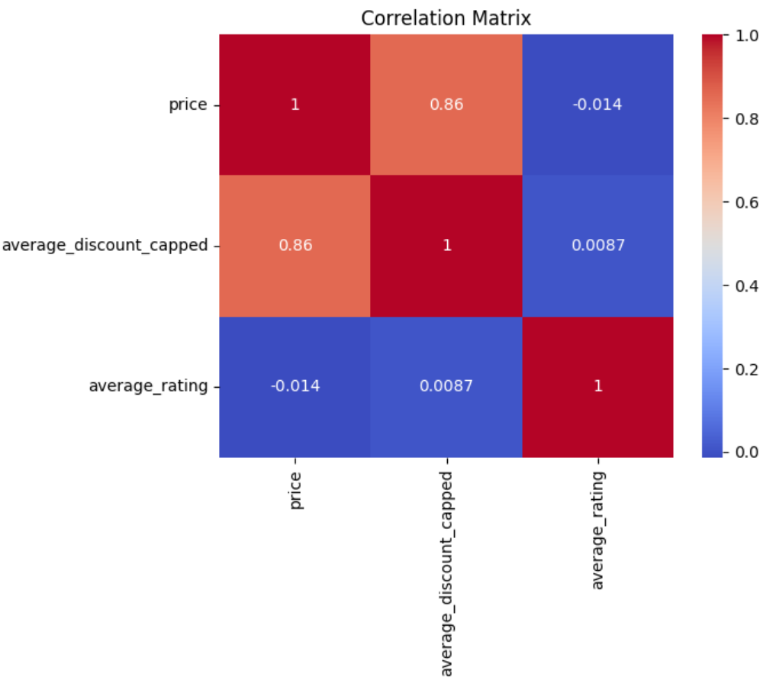
EDA

Slide 4
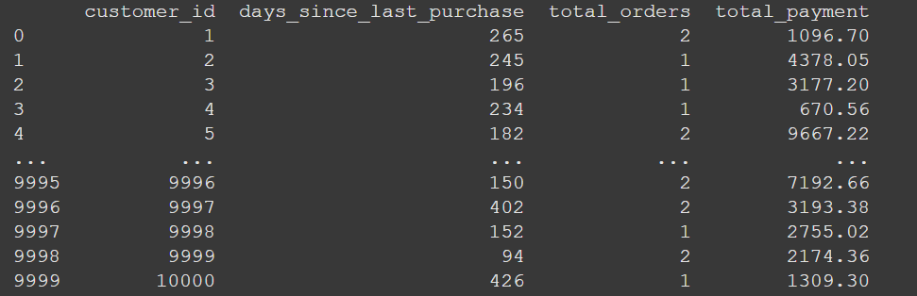
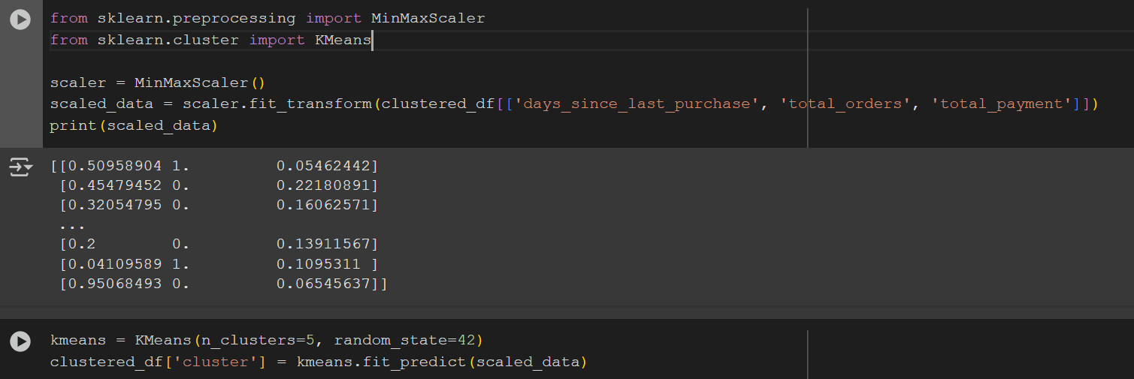
Clustering with RFM

Slide 5
Predictive Model

Slide 6
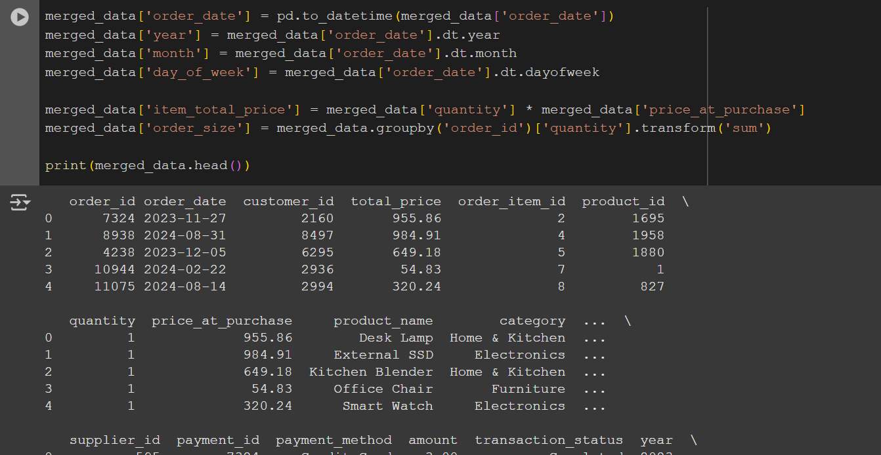
Merging Data and creating features to help the prediction

Slide 7
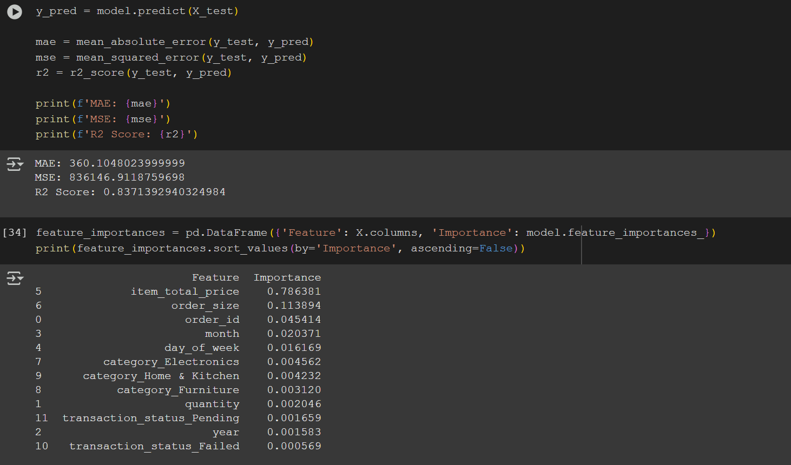
Initial results of trained model

Slide 8
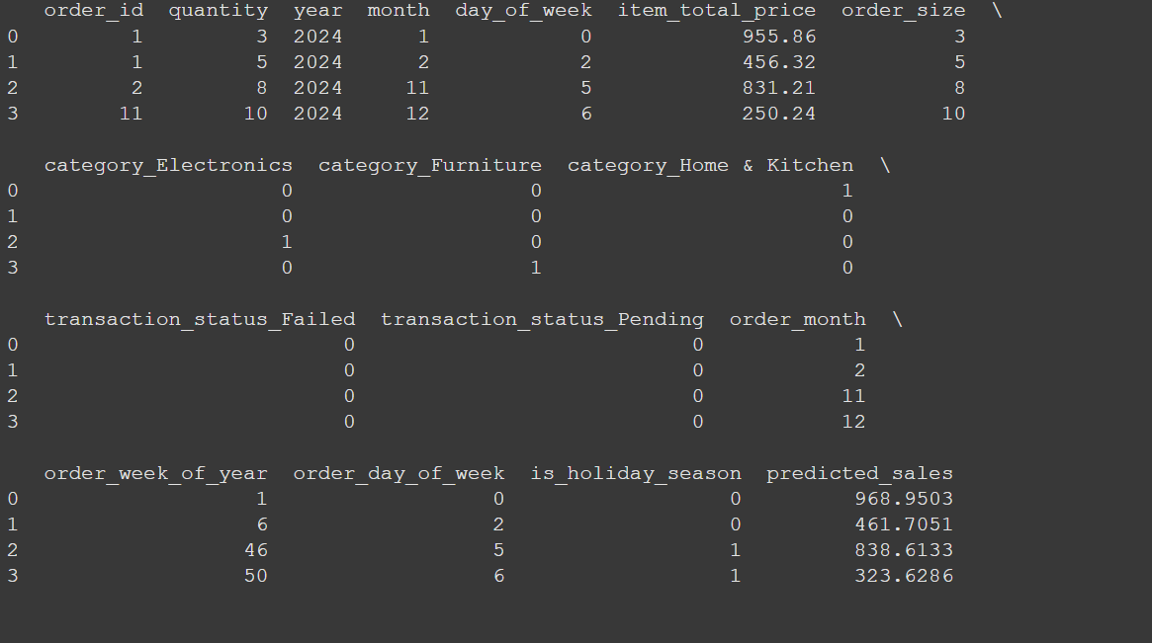
Prediction using retrained model for seasonal forecasting on simulated data

Slide 9
Dashboard
Main Idea behind this Dashboard was to understand
customer segments, product performance and trends
Main goals:
Understand Customer Segments
Evaluate Customer Ratings
Analyze Transaction Performance
Assess Product Pricing Trends
Track Products Performance Over Time

Slide 10
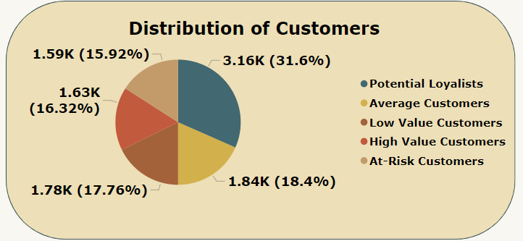
Customer Segments
Customer segmentation is crucial for tailoring strategies to different customer groups. By understanding the unique behaviors and preferences of each segment, businesses can optimize marketing efforts, improve customer satisfaction, and enhance overall profitability

Slide 11
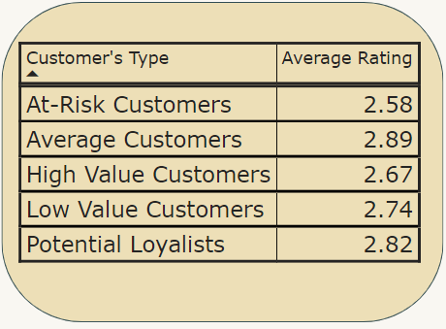
Average Rating by Customer Type
As we can see, customers across different clusters tend to rate products overall similarly, with only slight variations in average ratings between the groups

Slide 12
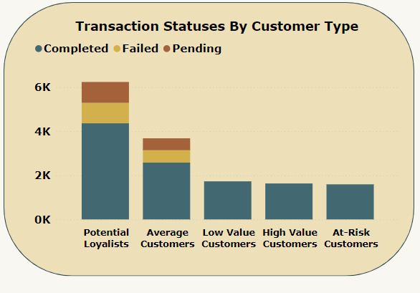
Analyze Transaction Performance
Potential Loyalists and Average Customers account for the highest number of total transactions.
Interestingly, they are also the only groups with failed and pending transactions

Slide 13
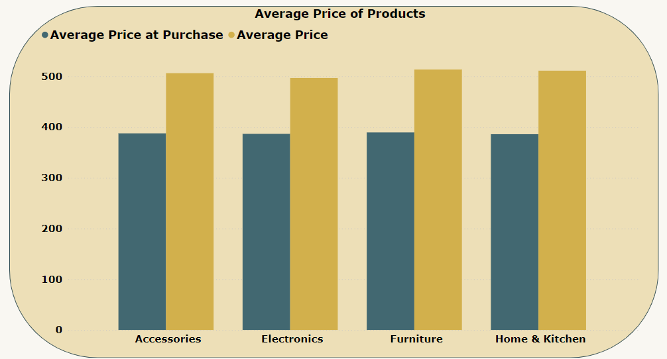
Product Pricing Trends
The comparison of average prices and prices at
purchase across product categories reveals
key insights about customer purchasing behavior.
For all categories, the average price at purchase
is lower than the average listed price, indicating
that customers tend to purchase items on
discount or promotions.
This trend suggests that pricing
adjustments and promotional offers play
a significant role in driving
sales for these categories

Slide 14
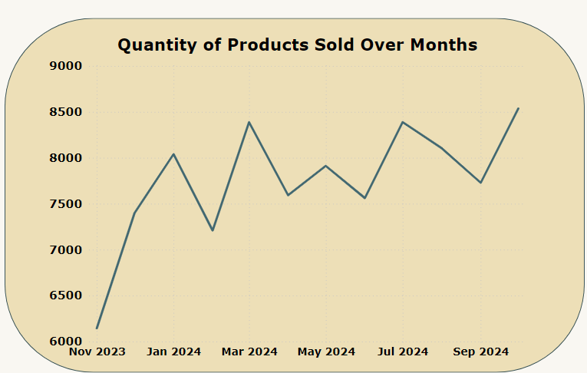
Sales Trend
Overall, product sales tend to increase
month by month, despite occasional
fluctuations and
spikes in certain periods

